Slide 1


U.S. Army MWR
Detroit Arsenal
CORPORATE PARTNERSHIP
SPONSORSHIP & ADVERTISING OPPORTUNITIES GUIDE
DENICE PRESEAU
SPONSORSHIP & MARKETING MANAGER
U.S. ARMY MWR - DETROIT ARSENAL
PHONE: 586-282-0969
EMAIL: DENICE.PRESEAU.NAF@ARMY.MIL

Slide 2
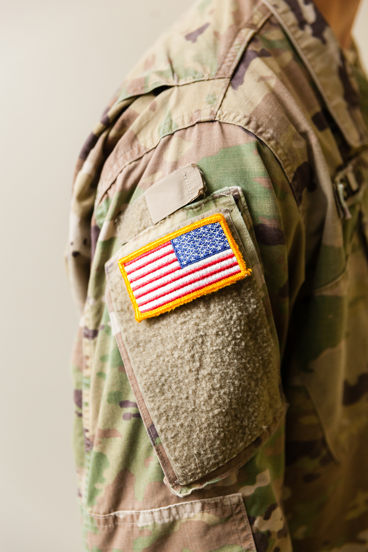

Our Army Community…
HAS TIME FOR
  LEISURE: Soldiers earn 30 vacation days a year.
  HAS MONEY TO SPEND: Soldiers typically have more disposable income due to a comprehensive benefits package including housing, medical, dental, etc.
  IS YOUNG: 58% of Active-Duty Soldiers are younger than 30, and the average age is 29.
  IS SMART: Army Soldiers are well educated. The G.I. Bill provides them and their families opportunities for further education.
  IS LOYAL: 64% of service members find brands more meaningful when they see their ads on an installation.
  The Detroit Arsenal has approx. 7,900 colleagues and more than 181,000 Military, Family members, Retirees, Veterans and DoD Civilians in the Detroit Metro Market. Our efforts reinforce The Army Strong message!
SOLDIERS • SPOUSES • FAMILIES • YOUTH • Veterans

Slide 3
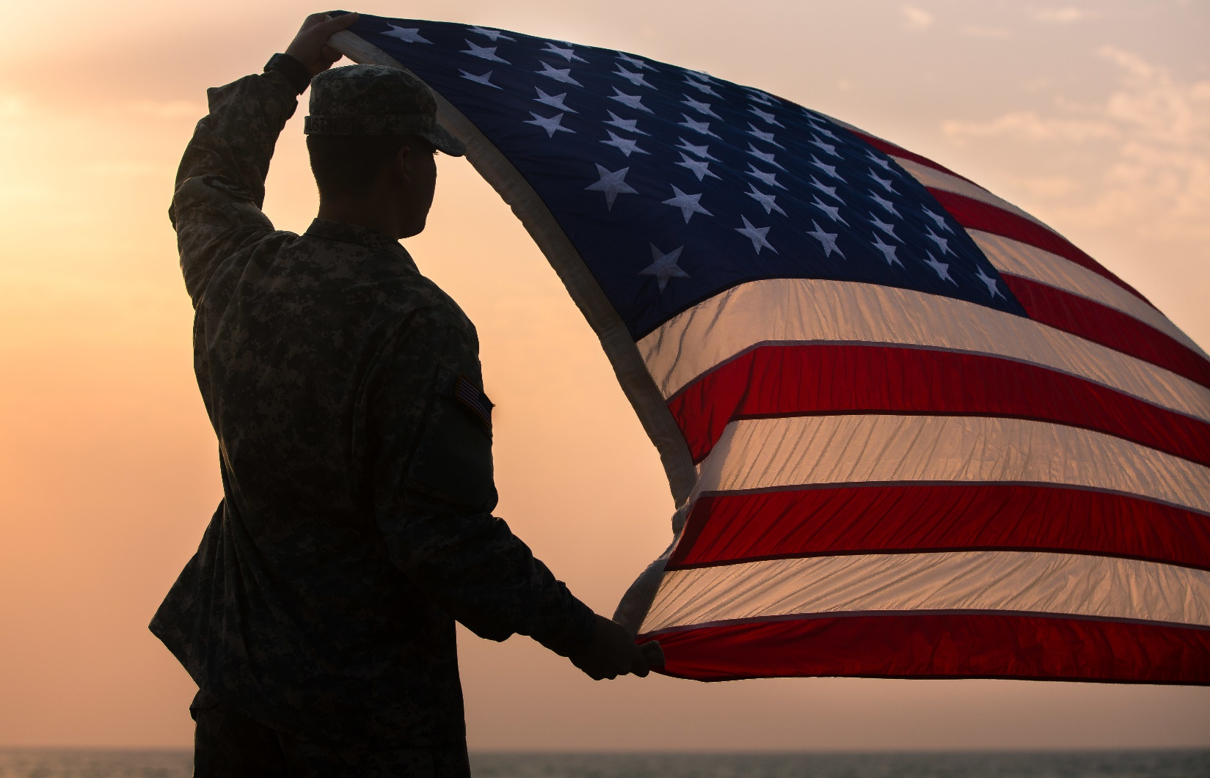
U.S. Army MWR Detroit Arsenal
PARTNERSHIP OPPORTUNITIES:
Commercial Sponsorship and Advertising is a Department of Defense program that opens the door for civilian businesses to sponsor Family and Morale, Welfare and Recreation (MWR) programs on the installation.
Sponsorship can be cash, products, or services. In return, you will be provided with logo coverage, advertising, couponing opportunities, plus other benefits. All revenue generated through sponsorship goes directly to MWR programs to make them successful.
Consider the impact your company can have on America’s Soldiers, Veterans, and their families by becoming a Corporate Sponsor.
CONTACT US TODAY!

Slide 4


Slide 5
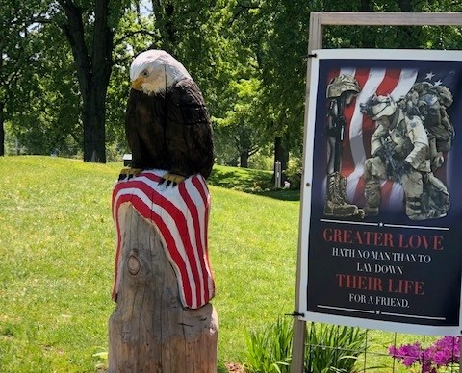
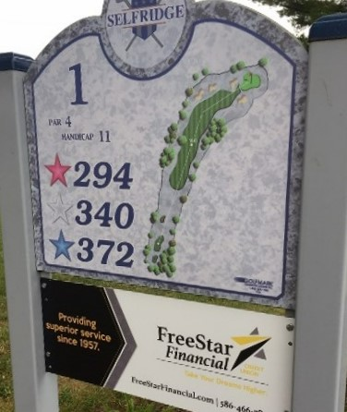


Selfridge ANG Golf Club
Advertising Options:
(2) Tee Hole Markers + (2) Golf Cart Logo Clings for 1 year
Only $2,500
(2) Golf Cart Logo Clings For (1) Year
Only $500
Score Card Ad for 1 year
(10,000 Score Cards)
$500
Premier Score Card Ad on 10,000 Score cards + 1000 Logo Pencils
$1200

Slide 6
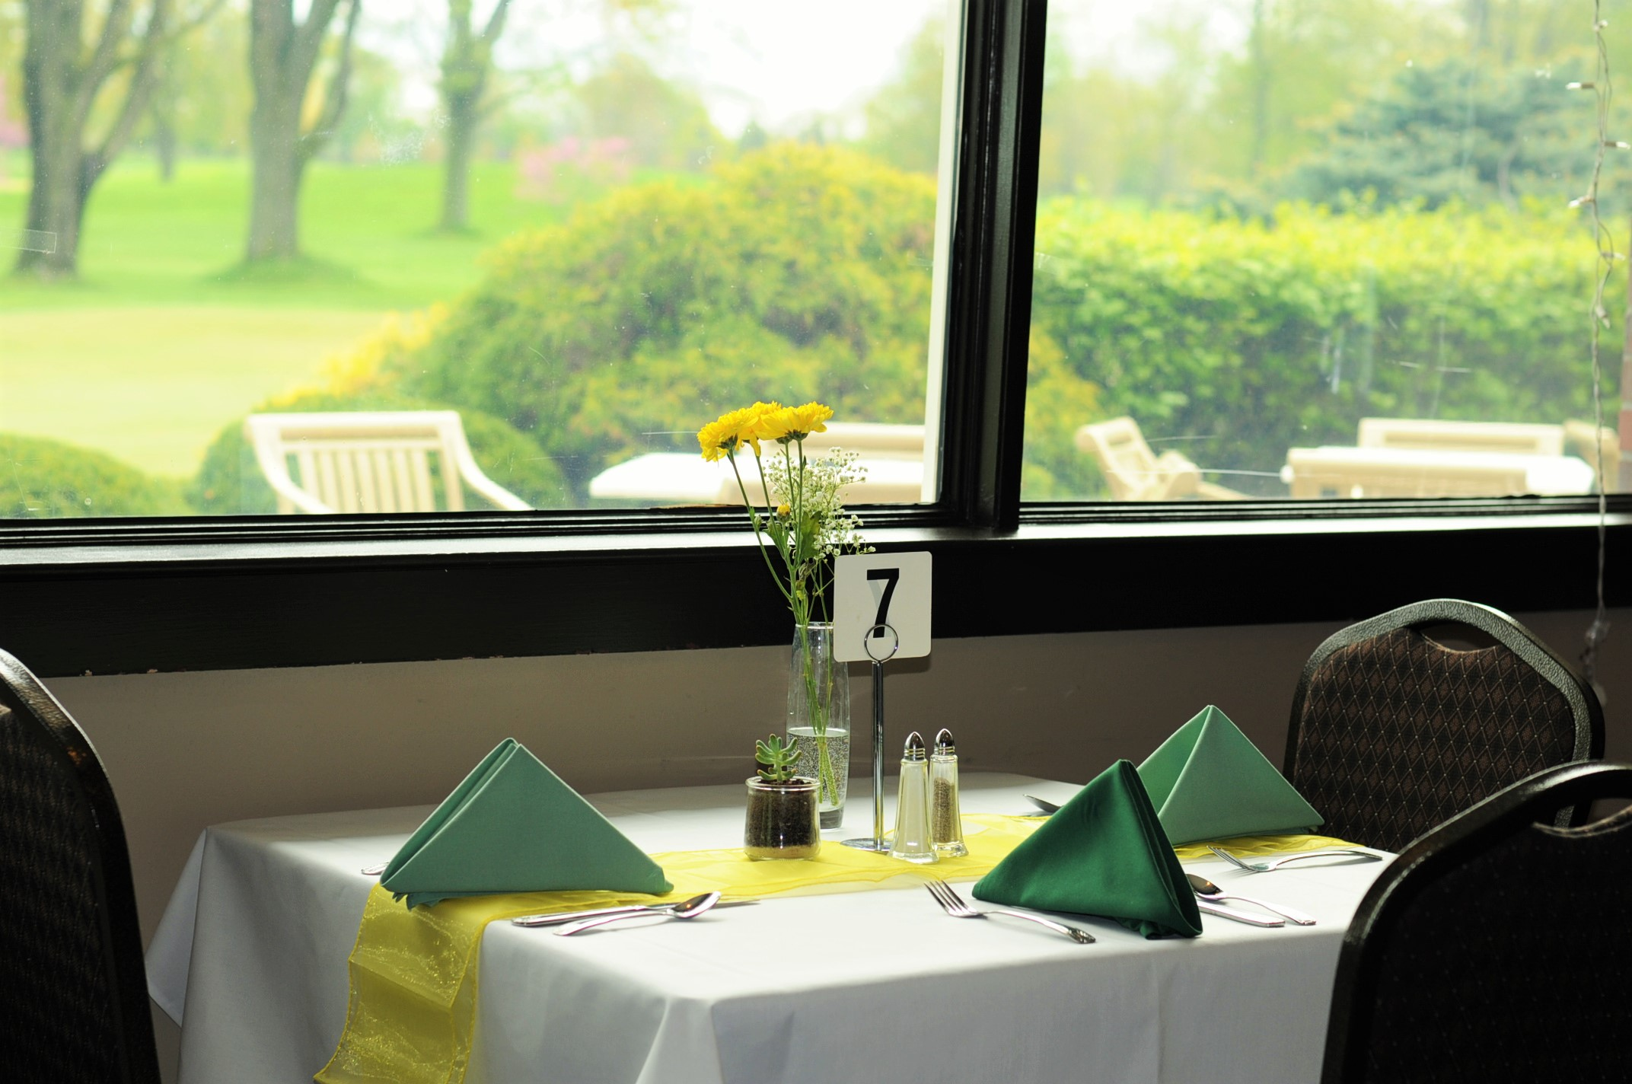
Mulligan’s Banquet Center
Catering and Conference Center at
Selfridge Golf Club
Opportunities Include:
  Pro Shop
  Food Truck and offsite catering!
  Golf Tournaments
  Golf Trainings
  Golf Outing
  Special & Seasonal Events
Seating Capacity:
Up to 250 and 12 additional bar seats
Conference (split room): 60-80 people
Golf Course Hours of Operation:
7am – Twilight from
April 1 - Nov 10

Slide 7
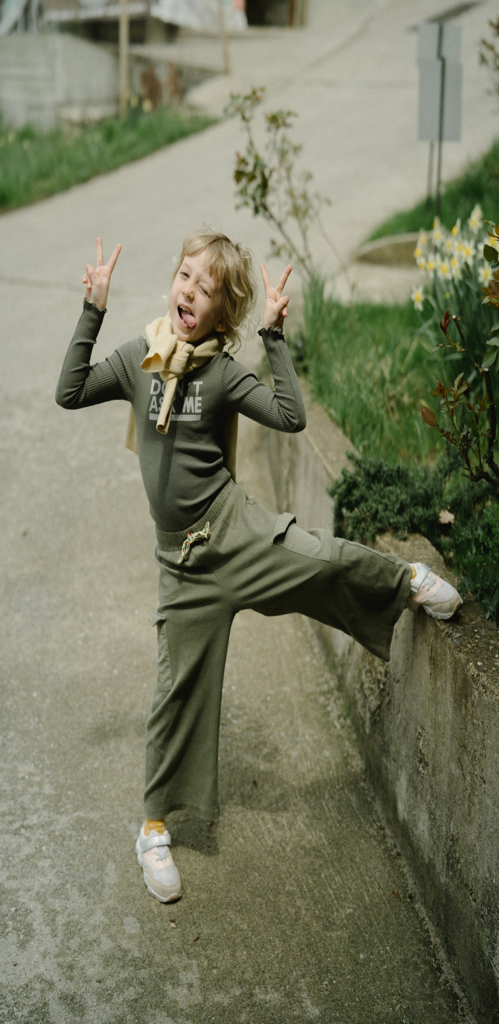
U.S. Army Garrison - Detroit Arsenal
Child and Youth Services
The Child and Youth Services Program supports our military families by reducing the conflict between mission readiness and parental responsibility.
Boys & Girls Clubs of America and the U.S. Armed Forces have partnered to help children of military families face the unique challenges of military life.
This no-cost membership provides our youth with the same high-quality programs and curriculums that traditional Boys & Girls Clubs provide.
Sponsorships and In-kind Gifts available for:
Fall Fest – October
STEM Center of Innovation
Youth Clubs: Mindfulness, Cooking, Lego, Theater, Gardening, Mental Health,
4-H Woodworking
Open Rec & ESPORT nights
Summer Camps
Youth Sports and Fitness
Field Trips

Slide 8
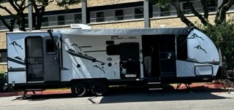
Outdoor RV Storage at Selfridge ANGB + DTA Storage
The Family and Morale, Welfare & Recreation (FMWR) Outdoor RV Storage offers secure and convenient options for vehicles, trailers, or RVs
Our Outdoor RV Storage consist of 3 lots and has ample space to accommodate 400 recreational vehicles. RV Storage — open year-round and located directly across from the Selfridge Golf Course. (Banners provided by the sponsor.)
Available Opportunities:
Banner Advertising
Customized advertising opportunities inside our RV rentals!

Slide 9
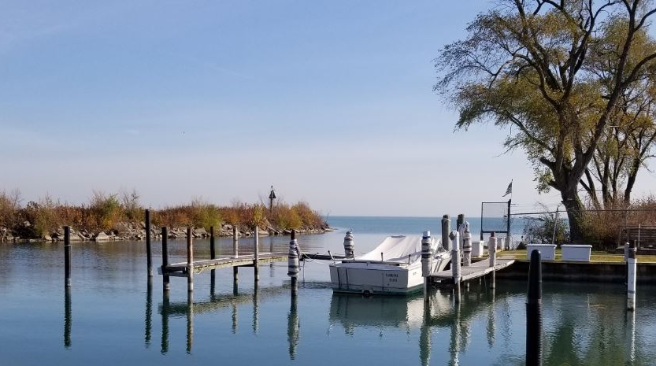
Selfridge Marina
at Selfridge ANGB
Located on the beautiful Lake St. Clair, the Marina at Selfridge, just a short drive from the main gate.
Available Opportunities:
  Customized advertising opportunities. Tell us what you need! (Examples include landscaping and design, host an event, or promote your product.)
  Banner Advertising

Slide 10
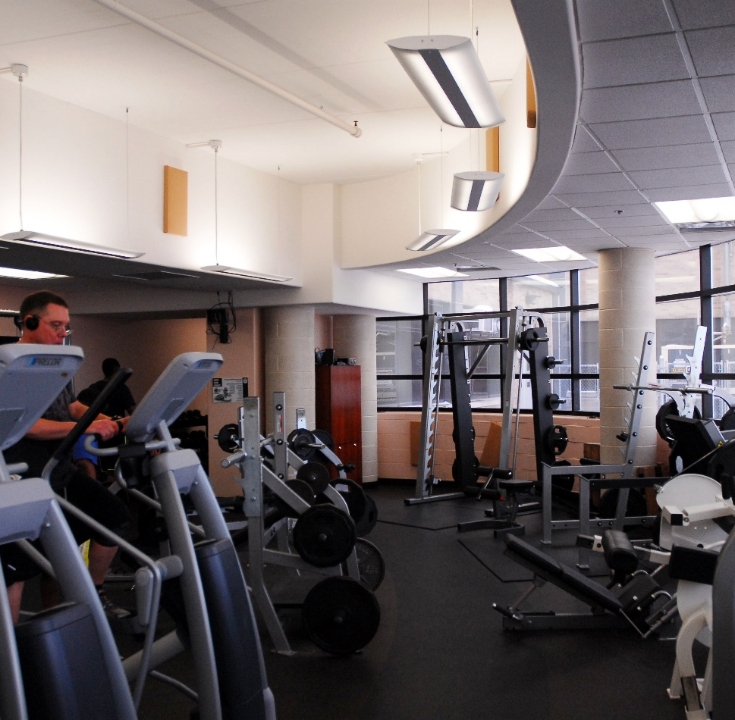
DTA Fitness Center Window Clings
Equipment Clings
Have an idea? Let’s talk!

Slide 11
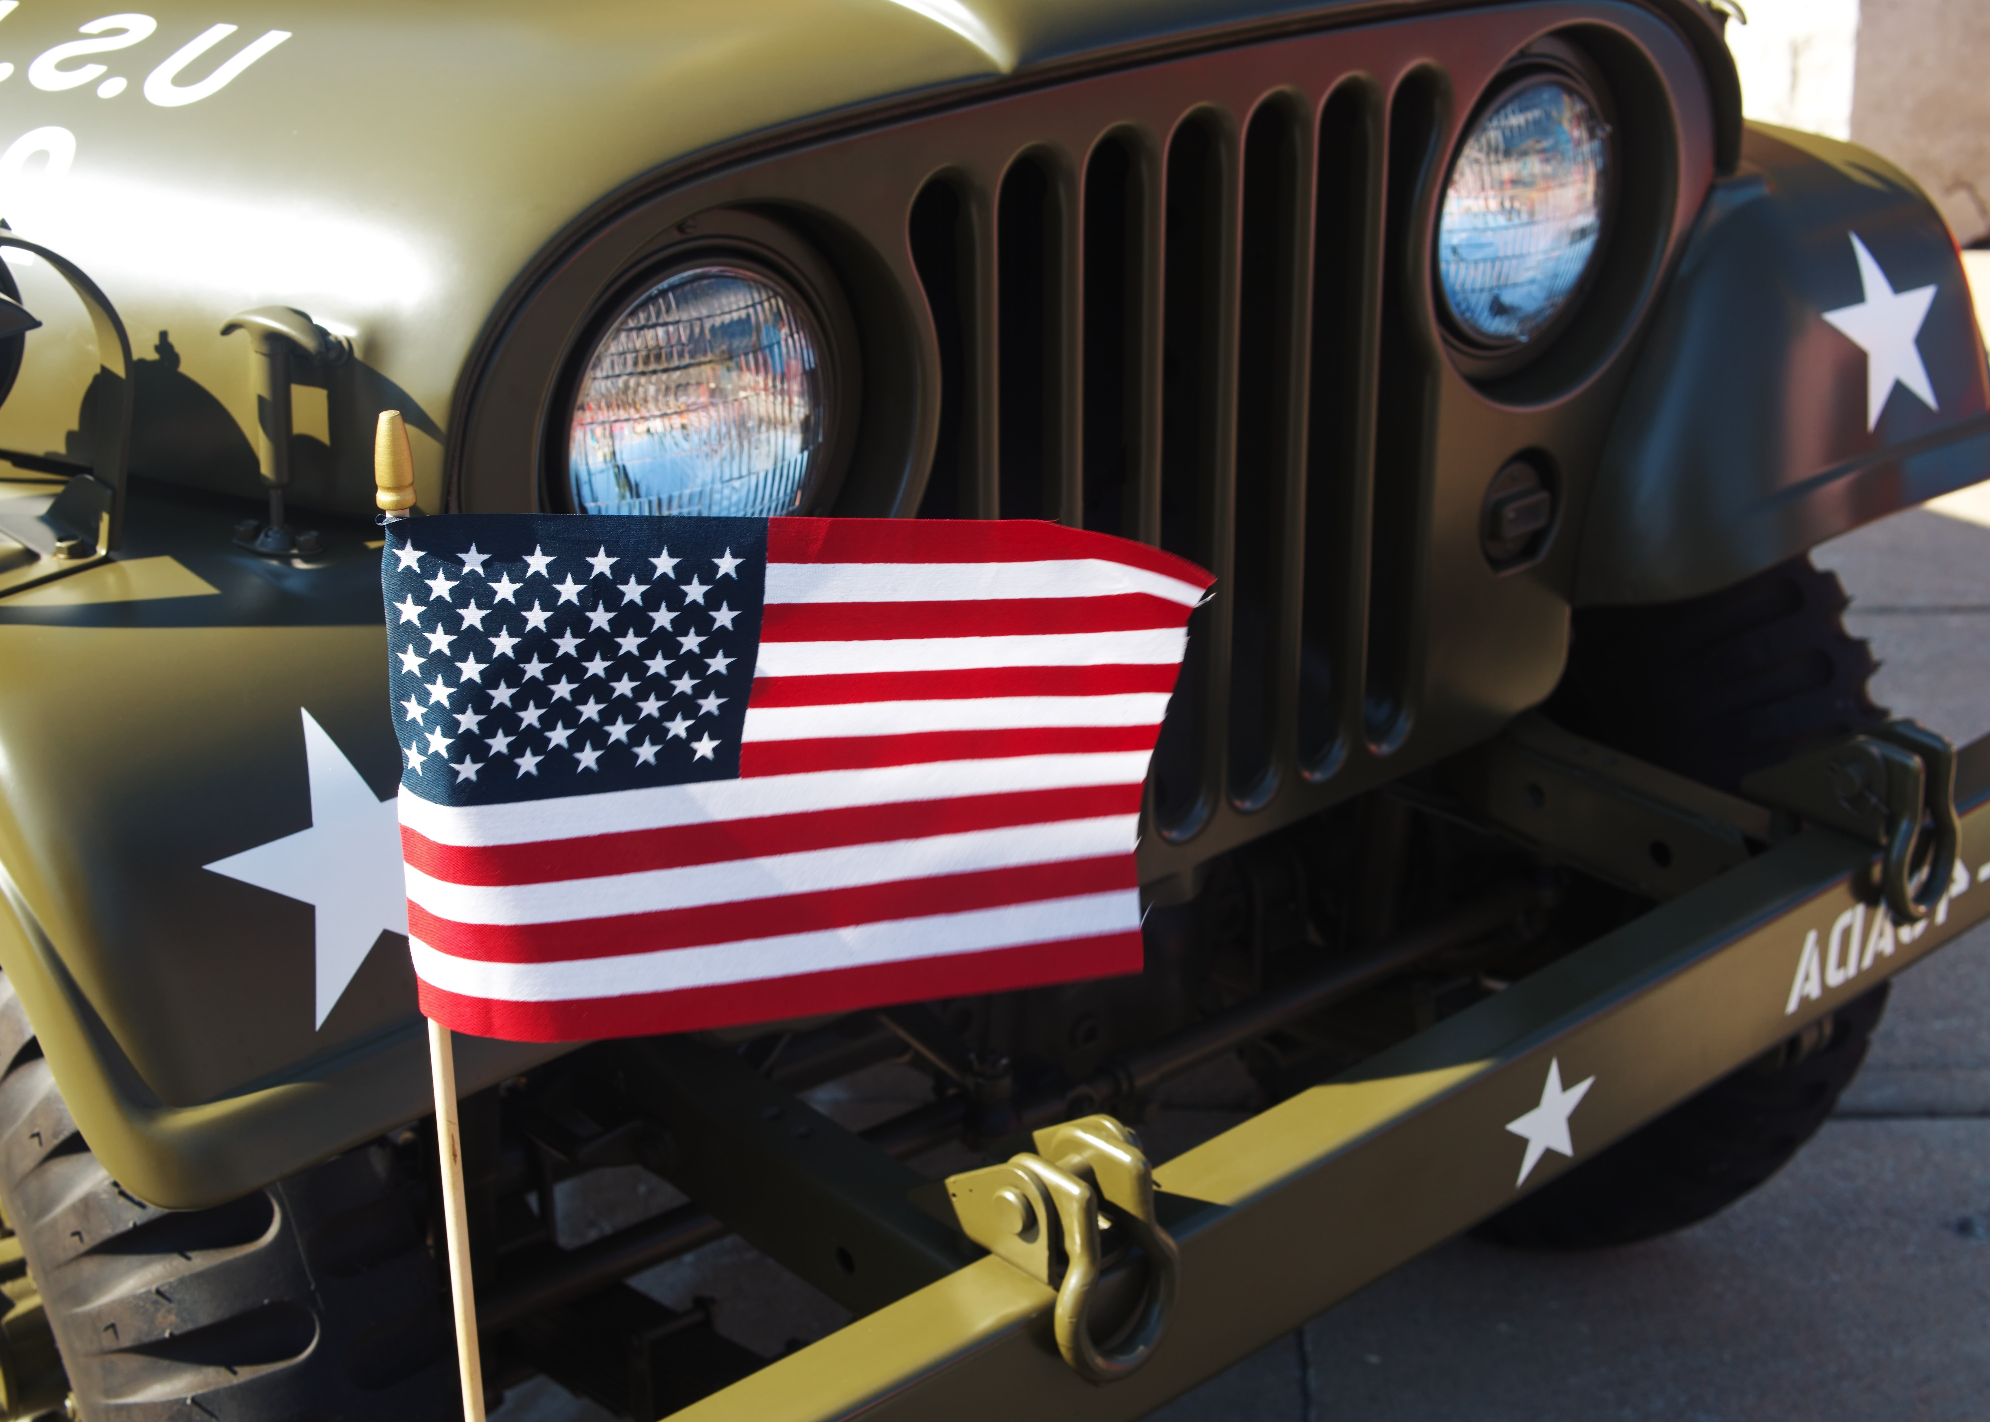
Morale, Welfare, & Recreation
Advertising Opportunities:
Customized Packages Are Always Available!
2025 Quarterly FMWR Flipbook
Gingerbread House Decorating Contest
Coming Soon: Coffee Shop Advertising
Coming Soon: Digital Advertising

Slide 12
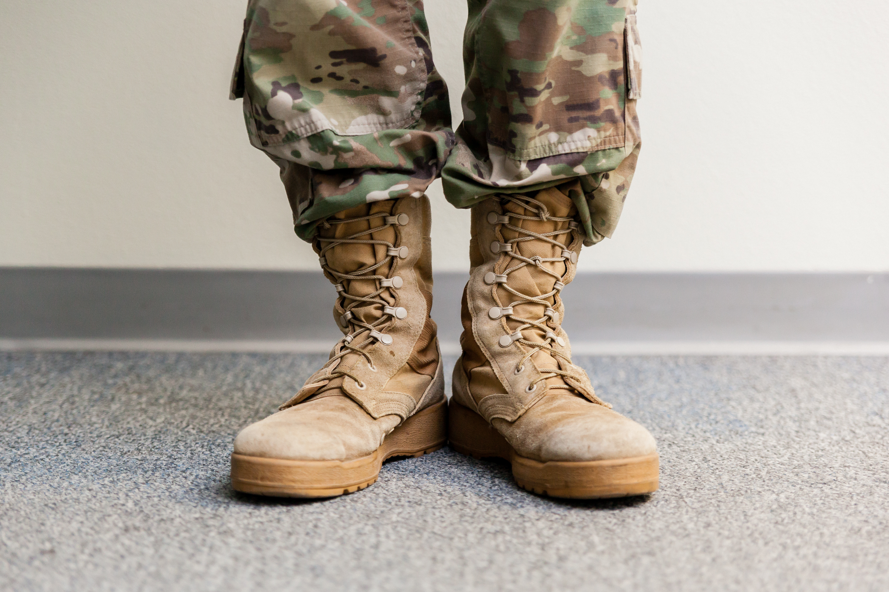
Additional Sponsorship and/or In-Kind Events Include:
Month of the Military Child (child abuse awareness) -April
Brunches - at Mulligan’s/Selfridge
Breakfast with Santa at Mulligan’s/Selfridge
CYC Summer camp
**Arsenal Family Picnic
**Holiday Tree/Tank Lighting
**Gingerbread House Decorating Contest
**Independence Day – July 4
**U.S. Army Family & MWR CYS Fall Fest or similar CYS event
**Opportunity for Sponsors to have an info Table available for
meet/greet attendees (when appropriate), workforce e-blasts and
listing inclusion on appropriate flyers/posters displayed through
the Detroit Arsenal & Selfridge ANG Base.

Slide 13
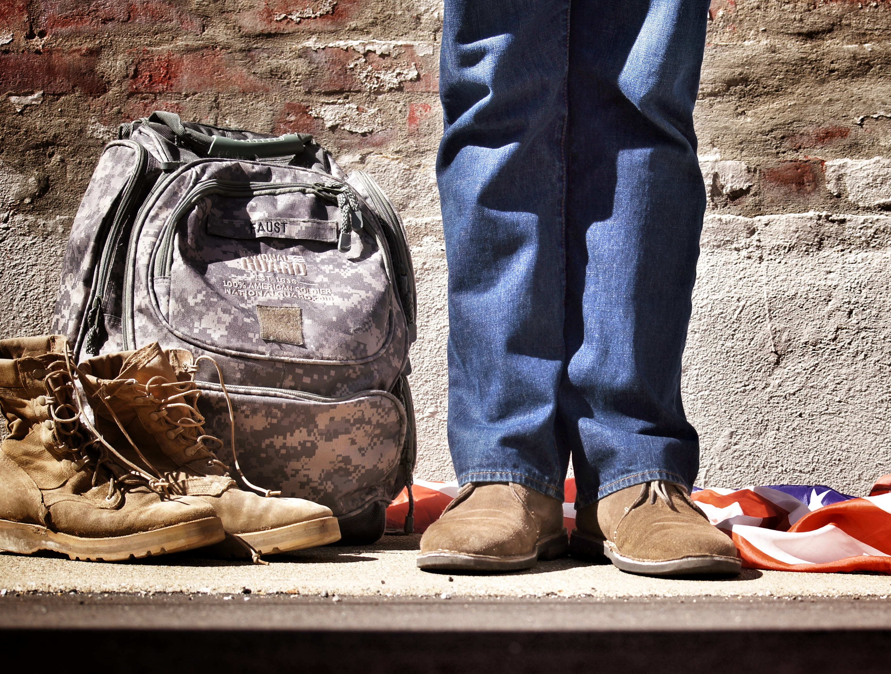
Company Budget :
Advertising ___ Sponsorship ___ In-Kind Sponsorship ___
Customized Package
_________________________________________________________
_________________________________________________________
_________________________________________________________
_________________________________________________________
_________________________________________________________
_________________________________________________________
_________________________________________________________

Slide 14
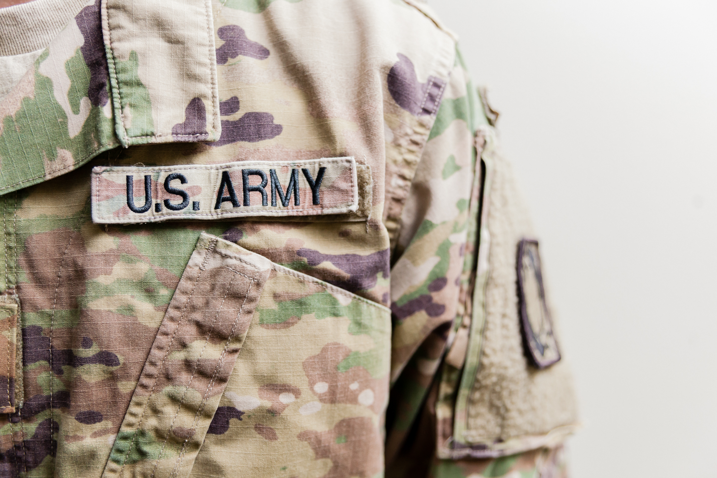
Thank you for your Support!
DENICE PRESEAU
SPONSORSHIP & MARKETING MANAGER
U.S. ARMY MWR - DETROIT ARSENAL
PHONE: 586-282-0969
EMAIL: DENICE.PRESEAU.NAF@ARMY.MIL

